Slide 1
OPTICAL RECEIVERS

Slide 2
Optical Detector and Optical Receiver
Drive circuit
Photodiode
Repeater
Modulator
Amplifier
Fiber
Fiber
Light source
Decider
Optical
Receiver
The optical receiver is an important part of the optical fiber communication systems, and its role is to convert the optical signals back to electrical signals
2

Slide 3
Introduction
The role of an optical receiver is to convert the optical signal back into electrical form and recover the data transmitted through the lightwave system.
Its main component is a photodetector that converts light into electricity through the photoelectric effect.
The requirements for a photodetector are similar to those of an optical source.
It should have high sensitivity, fast response, low noise, low cost, and high reliability.
Its size should be compatible with the fiber-core size. These requirements are best met by photodetectors made of semiconductor materials.

Slide 4
Optical receiver characteristics
Responsivity,
Quantum efficiency,
Rise time,
Bandwidth

Slide 5
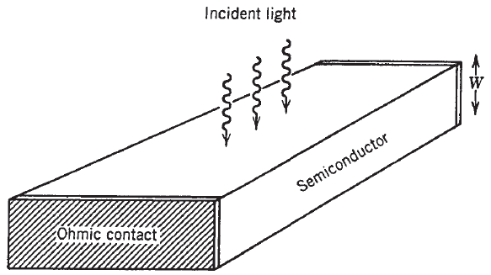

Responsivity and Quantum Efficiency
If the energy hv of incident photons exceeds the bandgap energy, an electron-hole pair is generated each time a photon is absorbed by the semiconductor.
The photocurrent Ip is directly proportional to the incident optical power Pin.

Slide 6

The constant Rd is referred to as the responsivity of the photodetector because more current is produced at a given input power for larger values of Rd
It is expressed in units of ampere/watts (A/W).
The responsivity Rd can be expressed in terms of a fundamental quantity, called the quantum efficiency and defined as

Slide 7

Responsivity is given by
The responsivity of a photodetector increases with the wavelength A simply because more photons are present for the same optical power.
In photoelectric diode, quantum efficiency range is 30%~95%. In order to get a higher quantum efficiency, we must increase the thickness of the depletion region. However, the thicker the depletion region, the slower the response speed of the photodiode. So we must make a compromise between the response and quantum efficiency.

Slide 8

Rise Time and Bandwidth
The bandwidth of a photodetector is determined by the speed with which it responds to variations in the incident optical power
Rise time Tr, defined as the time over which the current builds up from 10 to 90% of its final value when the incident optical power is changed abruptly.
rise time is found to be given by

Slide 9

The rise time of a photodetector can be written by extending
where the value in blacke t are the transit time and time constant of the equivalent RC circuit respectively.

Slide 10
Common Photodetectors
There are main four common photodetectors used.
PN – Photodetectors
PIN – Photodetectors
APD – Photodetectors
MSM - Photodetectors

Slide 11
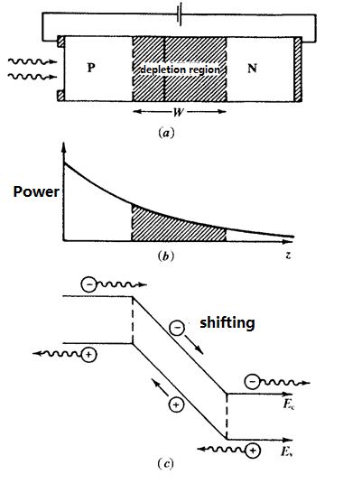
1. PN photodiode
Principle: the incident light from the side of P, absorpted in the depletion region, generates an electron-hole pairs. Under the influence of an external electric field, electrons and holes transit and form the photocurrent.
Response time: the delay of transformation from input to output, is mainly determined by the transit time of the depletion region.
11

Slide 12
A reverse-biased p-n junction consists of a region, known as the depletion region, that is essentially devoid of free charge carriers and where a large built-in electric field opposes flow of electrons from the n-side to the p-side (and of holes from p to n).
When such a p-n junction is illuminated with light on one side, say the p-side, electron-hole pairs are created through absorption.
Because of the large built-in electric field, electrons and holes generated inside the depletion region accelerate in opposite directions and drift to the n- and p-sides, respectively.
The resulting flow of current is proportional to the incident optical power.
Thus a reverse-biased p-n junction acts as a photodetector and is referred to as the p-n photodiode.

Slide 13

The responsivity of a photodiode is quite high (R ~ 1 A/W) because of a high quantum efficiency.
The bandwidth of a p-n photodiode is often limited by the transit time
If W is the width of the depletion region and vd is the drift velocity, the transit time is given by

Slide 14
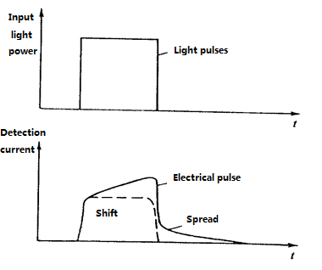
Diffusion component leads to distortion of the transient response of the photodiode
The main factors of bandwidth limition: the presence of the diffuse component in the photocurrent. It's ralated to optical absorption in the depletion region. It let the trailing output of lengthen, and influence the response speed
PN photodiode response to a rectangular pulse
Solution: reduce the thickness of P, N region, and increase the width of the depletion region--PIN
14

Slide 15
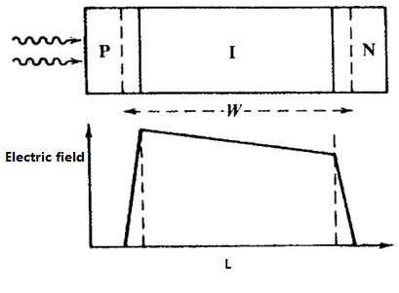
2. PIN photodiode
Inserting a layer of non doped or low doped semiconductor material between the PN junctions, in order to increase the depletion region width of W, to decrease the effect of diffusion, and improve the response. Because the semiconductor material between the PN junctions is like intrinsic semiconductor, we call this photodiode PIN photodiode.
Voltage basically fall in I region
Field distribution of PIN photodiode
15

Slide 16
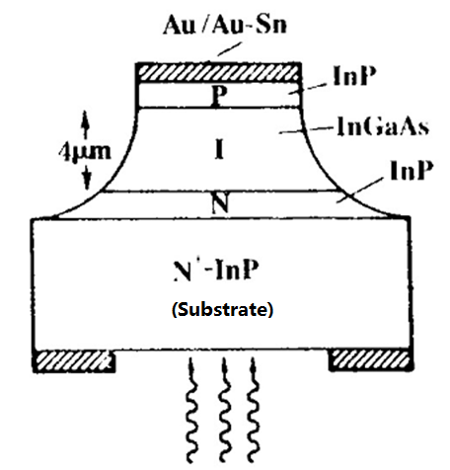
PIN photodiode
Double heterojunction structure:
N and P region: InP, transparent for the light λ> 920nm ；
I region: InGaAs； absorb the light λ=1300~1600nm
InGaAs PIN photodiode
16

Slide 17
Quantum Efficiency
The ratio of the number of photons can be converted to a current to the total number of photons of incident light is called the quantum efficiency.
The number of electron-hole pairs
The total photon number of incident light
In photoelectric diode, quantum efficiency range is 30%~95%. In order to get a higher quantum efficiency, we must increase the thickness of the depletion region. However, the thicker the depletion region, the slower the response speed of the photodiode. So we must make a compromise between the response and quantum efficiency.
17

Slide 18
Spectral Response
For a given material, there will be a maximum wavelength (λ_{C}) of light can be detected. For the light larger than this limit wavelength can not be detected.
When the photon energy (hυ) is larger than the band gap (E_{g}) of the semiconductor material, valence band electron can absorb a photon transition to the conduction band, otherwise no matter how strong the incident light is, the photoelectric effect will never occur.
18

Slide 19
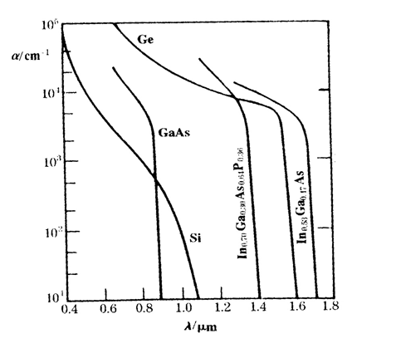
In the short wavelength section, the absorption coefficient of the materials becomes very large. So each material has a range of wavelength can be detected.
The relationship between the absorption coefficient of semiconductor and the wavelength
Si：λ_{C}=1.06μm, range：0.5~1.0 μm
Ge： λ_{C}=1.6μm, range：1.1~1.6 μm
InGaAs： λ_{C}=1.6μm, range：1.1~1.6 μm
19

Slide 20
Avalanche photodiodes (APD)
PIN: One photon--one pair of electron-hole, no gain
APD:The use of ionizing collisions, one photon--many electron-hole pairs, gain
1.Multiplication factor: M = I_{p} / I₀ I_{P}--The average output current,
I₀--Photocurrent
I_{P} ＝M I₀ ＝MRP_{in}
Multiplication factor is ralated to the ionization coefficient and the thickness of gain region.
2.Excess noise factor (F)
In APD, the amplification process is random, which will lead to fluctuations of the gain multiplier, and these fluctuations are the main source of multiplication noise. Often use excess noise factor (F) to represent this multiplication noise.
20

Slide 21
All detectors require a certain minimum current to operate reliably.
The current requirement translates into a minimum power requirement.
Avalanche photodiode (APDs) can have much larger values of Rd, as they are designed to provide an internal current gain in a way similar to photomultiplier tubes.
They are used when the amount of optical power that can be spared for the receiver is limited.
The physical phenomenon behind the internal current gain is known as the impact ionization

Slide 22
The energetic electron gives a part of its kinetic energy to another electron in the valence band that ends up in the conduction band, leaving behind a hole.
The net result of impact ionization is that a single primary electron, generated through absorption of a photon, creates many secondary electrons and holes, all of which contribute to the photodiode current.

Slide 23
Comparison of the photodetector
Si、Ge、InGaAs pin photodiodes common working parameters
Parameter | Symbol | Unit | Si | Ge | InGaAs
Wavelength | λ | nm | 400~1100 | 800~1650 | 1100~1700
Responsivity | R | A/W | 0.4~0.6 | 0.4~0.5 | 0.75~0.95
Dark Current | I_{D} | nA | 1~10 | 50~500 | 0.5~2.0
Rise time | τ_{r} | ns | 0.5~1.0 | 0.1~0.5 | 0.05~0.5
Bandwidth | B | GHz | 0.3~0.7 | 0.5~3.0 | 1.0~2.0
Bias voltage | V_{B} | V | 5 | 5~10 | 5
23

Slide 24
Comparison of the photodetector
Si、Ge、InGaAs APD common working parameters
Parameter | Symbol | Unit | Si | Ge | InGaAs
Wavelength | λ | nm | 400~1100 | 800~1650 | 1100~1700
Avalanche gain | M | —— | 20~400 | 50~200 | 10~40
Dark Current | I_{D} | nA | 0.1~1 | 50~500 | 10~50 @M=10
Rise Time | τ_{r} | ns | 0.1~2 | 0.5~0.8 | 0.1~0.5
Gain Bandwidth Product | M•B | GHz | 100~400 | 2~10 | 20~250
Bias voltage | V_{B} | V | 150~400 | 20~40 | 20~30
24

Slide 25
Comparison of the photodetector
In the short-distance applications, working in 850nm window, often use Si photodiodes.
In the short-distance applications, working in 1330nm and 1550nm window, often use Si photodiodes, often use InGaAs photodiodes.
Compared with PIN photodiodes, APD has a multiplier effect of the carrier, the detection sensitivity is particularly high, but requires a higher bias voltage and temperature compensation circuitry.
25

Slide 26
Noise characteristics of optical receiver
Noise will affect SNR and the communication quality. Noise mainly come from photodetector and preamplifier, and is divided into two types: the shot noise and thermal noise.
Receiver noise and distribution:
Photon
Bias resistor
photodetector
Amplifier
hυ
R_{L}
Quantum noise
Dark current noise
APD multiplication noise
Thermal noise
Amplifier noise
Shot Noise
26

Slide 27
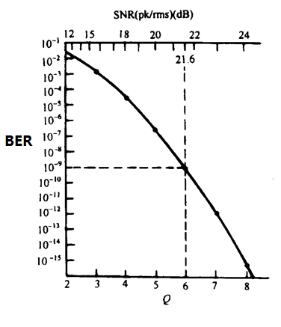
Sensitivity of optical receiver
Sensitivity: the minimum average optical power received, when the receiver work at a certain bit error rate.
Bit error rate(BER):
the rate that the receiver decision
circuit makes a error bit.
Q is widely used to describe the characteristics of the receiver.
Q=6，BER=10E-9
Q>7， BER<10E-12
27

Slide 28
The optical signal optical transmitter sends out is not the ideal bit flow, and may deform in the optical fiber transmission process. In the non ideal condition, the sensitivity of the receiver increases, and the increased power is called the powerpenalty, also known as the sensitivity degradation.
28

Slide 29
Performance evaluation of optical receiver
1.The bit error rate curve
2.The code length effect
3.Eye diagram: The most intuitive and simple method
Formation: Eye diagram is a comprehensive reflection that repeated random signal added together during the scanning
process.
29

Slide 30
Eye diagram analysis
t₂
t₁
Threshold
V₁
V₂
The best moment of judgment
1. The best moment of judgment
2. Noise tolerance
3. Clock jitter
4. The thickness reflects the noise
30

Slide 31
END

